Slide 1
Efforts to Gauge Culture of Assessment by the Academic Assessment Committee at UF
10.10.15

Slide 2
Review of Past Work: 2014 Survey of UF SACS Coordinators
1. Started with validated survey
2. Modified to delete items and add our own items
3. Obtained IRB approval (IRB2 2014-U-0242)
4. Created on-line survey and sent link via e-mail
5. Response Rate = 11 out of 17 = 65%
Welsh, J. F., & Metcalf, J. (2003). Cultivating faculty support for institutional effectiveness activities: Benchmarking best practices. Assessment & Evaluation in Higher Education, 28(1), 33-45.

Slide 3
Review of Past Work: 2014 Survey of UF SACS Coordinators
Efforts to evaluate the effectiveness of my college’s degree PGs/SLOs are worthwhile
PGs/SLOs will be important part of SACSCOC accreditation in the future
Analyzing PGs/SLOs are not important part of my job
PGs/SLOs are primarily the responsibility of university staff outside my college
Developing PGs/SLOs is a fad that will likely be replaced by another area of emphasis
PGs/SLOs in my college is strengthened by active participation by faculty
Resources dedicated to PGs/SLOs outcome activities are investments in the long-term effectiveness of my college
Documenting PGs/SLOs should be integral to college/department-speciﬁc SACSCOC accreditation criteria

Slide 4
Initiatives as a Result of the Survey
Office of Institutional Assessment modified annual training
Emphasized that we support training initiatives in the field (one-on-one, small groups, telephone support)
Emphasized flexibility in training
Initiated interviews with college representatives, stakeholders responsible for assessment data
What duties comprise your role/job?
Describe annual data collection process
How do you handle training?
How do you motivate faculty? New faculty?
What do you do when data is not entered or entered inadequately?
Know when to retire PGs/SLOs?
Have you attempted to align other accreditor with SACS?
1
2
3
Better understanding of how each college works to be more responsive during planning and reporting phases

Slide 5
Initiatives as a Result of the Interviews
Evidence: Centralized data entry produces the highest quality results
Result: This is what we will recommend in the future
Evidence: Training styles varied depending on the size of the department or college: regular agenda item in faculty meetings, one-on-one training, ad-hoc meetings, etcetera
Result: Data supports that we continue to offer training to comply with SACS in multiple formats: web, video, PDF, phone, face to face
Evidence: Some units did not use data collected to improve programs
Result: We suggested ways they could be used (e.g., template for other accrediting bodies, program improvement processes)
Notes:
Comprehensive Standard 3.3.1 = Institutional Effectiveness

Slide 6
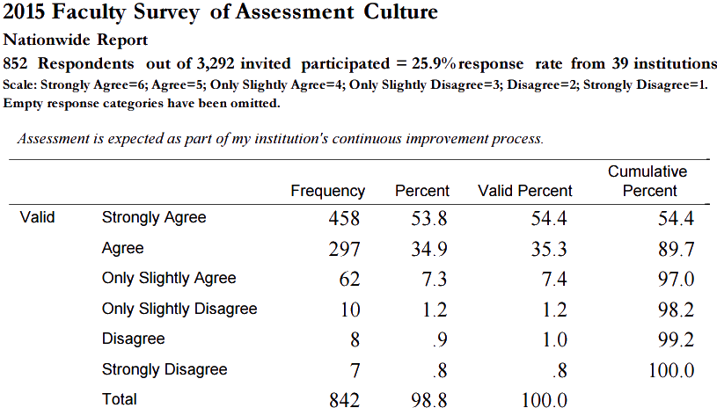
2016 Survey of Faculty on Culture of Assessment
For consideration
Would the results of a faculty survey be valuable to the committee?
Can the results help improve assessment?
AAC Subcommittee will
Determine whether to use existing survey
or develop our own
Develop, deploy, and summarize results
Present findings at a future AAC meeting
Results Table Example from a National Survey

